Slide 1
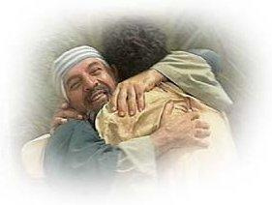
Asking Forgiveness
Chapter 17

Slide 2
The Prodigal Son
God is always ready to forgive our sins.
The story of the Prodigal Son shows how God wants to forgive us.
Read Luke 15:11-32, which is the story of the Prodigal Son.

Slide 3
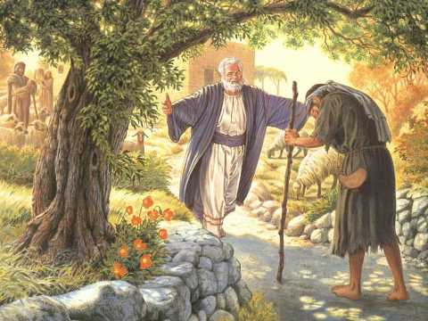

Slide 4
O my God,
I am heartily sorry
Heartily = With all my heart

Slide 5
for having offended You
offended = hurt

Slide 6
And I detest all my sins
detest = hate

Slide 7
because I DREAD the loss of Heaven
dread = fear or sorrow at losing something
not surprised by “I know it’s coming”

Slide 8
and the pains of Hell

Slide 9
But most of all because they offend Thee my God
offend = hurt

Slide 10
Who are all good and deserving of all my love
deserving = worthy

Slide 11
I firmly resolve with the help of Thy grace.
firm = strongly
resolve = promise
no whimps

Slide 12
To confess my sins
Confess = tell

Slide 13
to do penance
Penance = something we do to make up for the wrong we have done

Slide 14
And to amend my life
Amend = change

Slide 15
Amen
Amen = Yes! I believe

Slide 16
Act of Contrition
O my God,
I am heartily sorry for having offended Thee.
And I detest all my sins, because I dread
the loss of Heaven and the pains of Hell.
But most of all because they offend Thee my God,
Who are all good and deserving of all my love.
I firmly resolve with the help of Thy grace.
To confess my sins, to do penance
And to amend my life. Amen

