Slide 1
5 Steps to a Good Confession

Slide 2

1.
Examine your conscience.
Pray to the Holy Spirit:
Look into our hearts
Know what Jesus taught
(10 commandments, beatitudes, parables).
3. Tell right from wrong.
4. Be sorry.

Slide 3

2.
Sorrow for sins.
To be forgiven you must:
Confess what you did,
Be truly sorry, and
Amend your life.

Slide 4
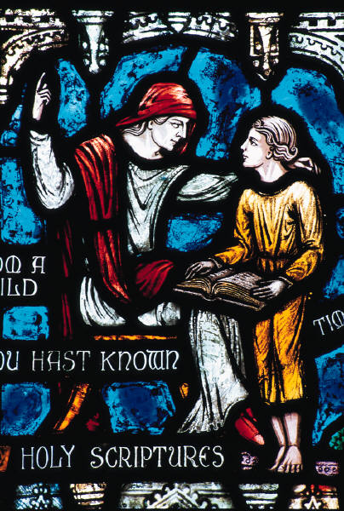
3.
Amend your life
Make up your mind
not to sin again

Slide 5
4.
Confess your sins to a priest and receive Absolution (receive forgiveness)
Jesus acts through the priest.
Any Catholic priest can forgive your sins!
Tell the priest:
What you did.
Why you did it.
How often you did it.
The priest CANNOT tell your sins to ANYONE! This is called the Seal of Confession.

Slide 6
5.
Do Penance to make up for sins.
Are you really sorry you hurt Jesus?
Do your penance right away!
Amend your life =
Try not to do the same things again.
Tell Jesus, “THANK YOU!”

