Slide 1
Jesus Forgives
Chapter 18

Slide 2
Jesus
Jesus cured many different sick people.
There were many times he forgave their sins.
Jesus is always ready to forgive us when we are sorry for having sinned.

Slide 3
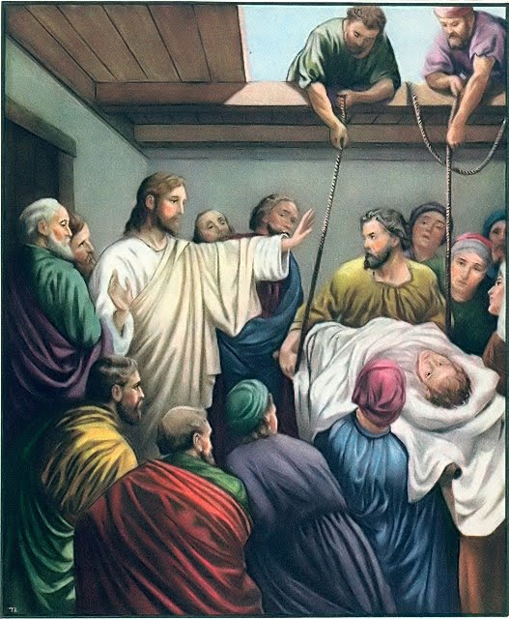
Your sins are forgiven

Slide 4
First Apostles
Jesus made some of his disciples the first priests of the Church.
He gave them the power to forgive sins.
Priests today have the power to forgive sins through the sacrament of Confession.

Slide 5
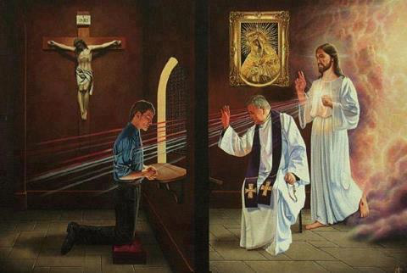
Jesus acts through the priest

Slide 6
Words of Absolution
"I absolve you from your sins in the name of the Father, and of the Son, and of the Holy Spirit."
These are the words of absolution that the priests says after you have confessed your sins.

Slide 7
Sacrament of Penance
The Sacrament of Penance is also called Confession or Reconciliation.
What's the difference between the two?
i. Confession- “to tell”- we tell our sins to Jesus through the priest
ii. Reconciliation- “restore a friendship” – our friendship with God is restored

