Slide 1
Making up for our Offenses
Chapter 20

Slide 2

Penance and Forgiveness
Forgiveness
  Letting go of an evil or offense done to you by another person.
Penance
  A way of making up for the punishment of a sin

Slide 3
An Example
Boy throwing a ball in the house
He broke his mother’s vase.
He told his mother about it and he was sorry.
  She forgave him.
  Was that all that had to be done?
He picked up the broken pieces.
He picked flowers to give to his mother.
  What would we call this part?

Slide 4
How can penance help us say “no” to sin?
It reminds us how we offend God.
It reminds us that sin has consequences.
It reminds us we need to overcome sin.
It helps us get strong by not putting ourselves first.
It helps us understand how sin affects God, others and ourselves.

Slide 5
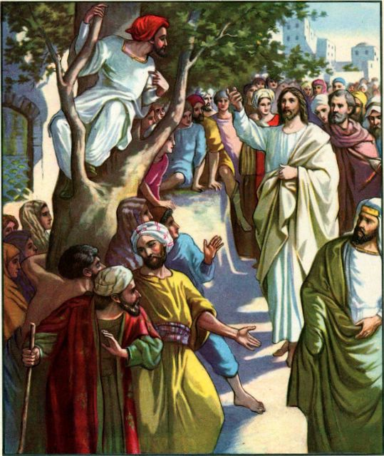

Slide 6
Story of Zacchaeus
Read Luke 19:1-10

Slide 7
What did we learn?
Was Zacchaeus tall? How do we know?
Why did Zacchaeus want to see Jesus?
Was Zacchaeus a good man? Did he steal?
Why was Zacchaeus sad?
What did Jesus ask of Zacchaeus?
How did Zacchaeus feel after Jesus talked to him?
How did Zacchaeus make up for his sins?
How is Zacchaeus a good example for us?

