Slide 1
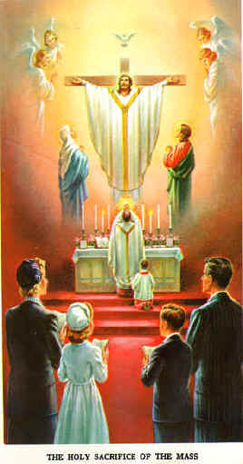
The Holy Mass
The Perfect Sacrifice Part II

Slide 2
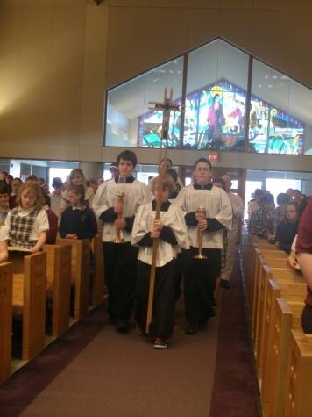
Introductory Rites
Entrance Procession (and song)
Sign of the Cross
Greeting
Penitential Rite
Confiteor
Kyrie
Gloria
Opening Prayer

Slide 3
Entrance Procession (and Song)
The entrance procession takes us into Heaven,
singing songs of praise to God our Father.

Slide 4
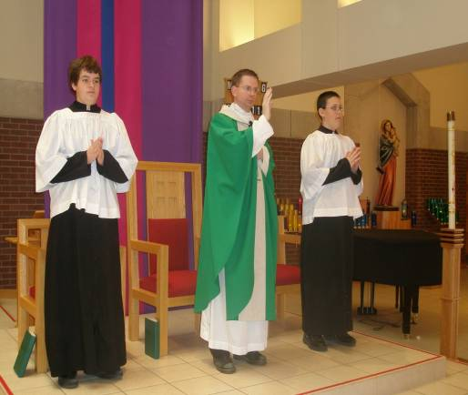
Sign of the Cross & Greeting
The Sign of the Cross reminds us of the Trinity,
and helps me remember Jesus died for me.

Slide 5
Penitential Rite
Penitential Rite
In the penitential rite we sing Kyrie,
Lord have mercy,
wash my sins away.
Gloria/
Opening Prayer
With the angels we sing Gloria to the King,
And the opening prayer reminds me why I’m there. Amen.

Slide 6
Liturgy of the Word
First Reading (often OT – Old Testament)
Responsorial Psalm
Second Reading (Sunday, often NT – New Testament)
Gospel Acclamation/ Alleluia
Gospel
Homily
Creed
Intercessions/Petitions

Slide 7
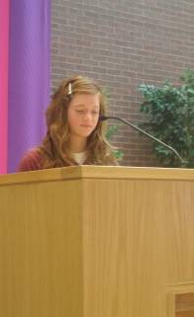
Readings
Body posture?
Sit – why?
Ready to listen and receive; sit and talk with a good friend
Look at the lector (reader)
First Reading (God speaks to us ↓)
Taken from the Old Testament
“The Word of the Lord.”
“Thanks be to God.”

Slide 8
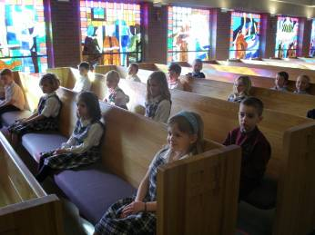
Readings
Responsorial Psalm (We reply back to God ↑)
Songs of praise from the Psalms
“The Lord is my Shepherd, I shall want.”
Second Reading (God speaks to us ↓)
Taken from the New Testament
“The Word of the Lord.”
“Thanks be to God.”

Slide 9
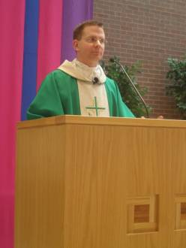
Readings
Alleluia/Praise to You, Lord Jesus Christ
Body posture?
Stand to Greet Jesus
Sing because we are so joyful to hear Jesus
Gospel (Good News!)
Only a priest or deacon can read – Why?
stand in place of Jesus
Homily
Body posture?
Sit to listen and receive
Father explains the Gospel/readings to us

Slide 10
Liturgy of the Word
Creed (Profession of Faith)
The prayer that says what we all believe
Body posture?
Stand to show that we will stand up for our Faith
General Intercessions (Petitions)
We stand to pray for the needs of the whole Church
Pope, Leaders, Poor/sick/needy, Community needs

Slide 11
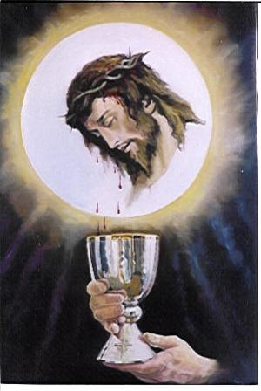
Liturgy of the Eucharist
Offertory
Holy Holy (Sanctus)
Eucharistic Prayer
Consecration
Memorial Acclamation/Amen
Lord’s Prayer
Lamb of God (Agnus Dei)
Communion
Prayer after Communion

Slide 12
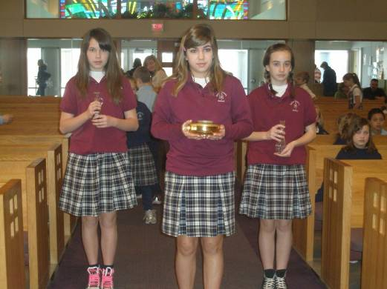
Offertory
When we offer the bread and wine…
We offer our hearts to God!

Slide 13
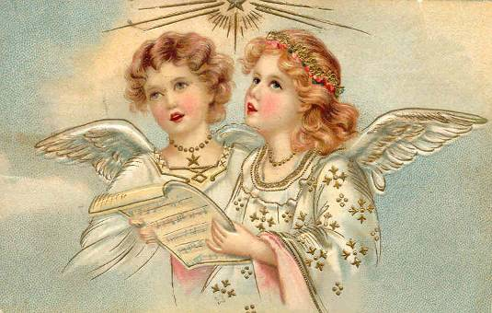
Holy, Holy, Holy (Sanctus)
We sing what the angels are singing in Heaven!

Slide 14
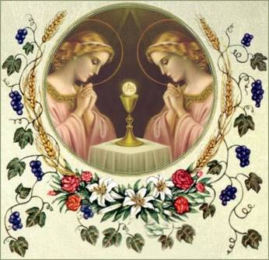
Eucharistic Prayer
Eucharist means “Thanksgiving”
This prayer thanks God for giving us Jesus to die and rise for us

Slide 15
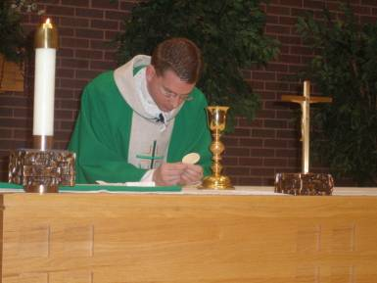
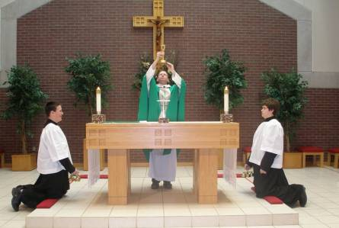
Consecration
In the Consecration Father says the words of Jesus
(bread) “This is My Body”
(wine) “This is the cup of My Blood”

Slide 16
Memorial Acclamation/Amen
We sing what we believe:
We proclaim your death, O Lord and profess your resurrection until you come again
Father holds up Jesus and proclaims the Mystery of Faith: “Through Him, with Him, in Him, in the unity of the Holy Spirit, all glory and honor is Yours, Almighty Father, forever and ever”
We sing, “AMEN!” (we believe and agree)

Slide 17
Lord’s Prayer
We pray in the words Jesus taught us
The Our Father asks God for all we need:
Praise God for being our Father
Asks God for His will to be done
We forgive others and ask forgiveness
We ask for our daily bread (Eucharist! And other graces)
We ask to be protected from evil

Slide 18
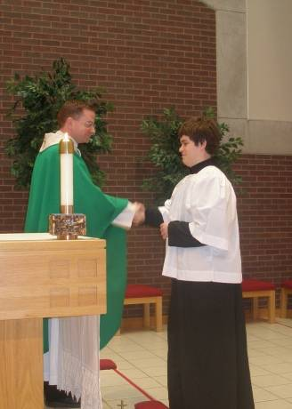
Sign of Peace
We show we are at peace with God when we are at peace with all those around us
Shake everyone’s hand near you

Slide 19
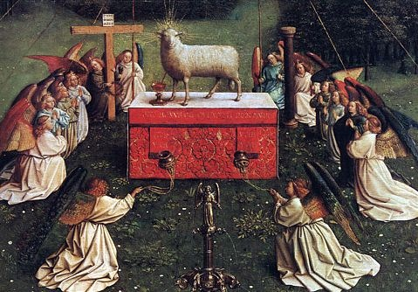
Lamb of God (Agnus Dei)
Remember, Jesus died for us like a lamb died for the Jews in Egypt
His Blood saves us!

Slide 20
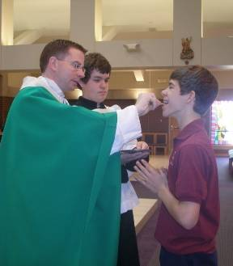
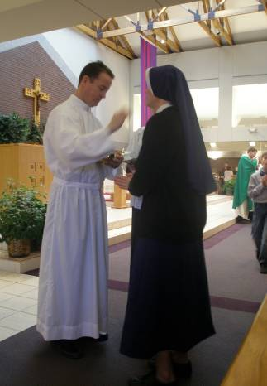
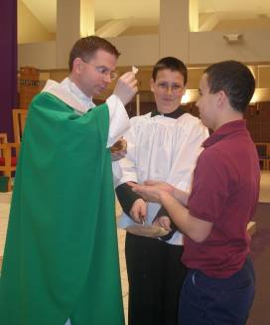
Communion
We receive Jesus into our souls!!!!!!!!!! ☺

Slide 21
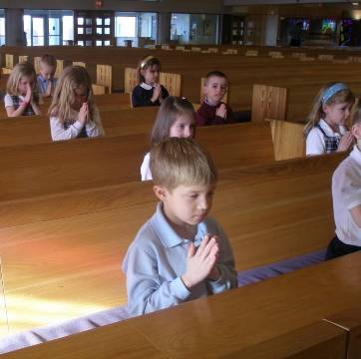
Prayer after Communion
We take time to thank and praise Him
We stand and Father closes with a prayer after we receive Jesus and to prepare for the end of Mass.

Slide 22
Concluding Rite
Blessing
Dismissal – “The Mass is ended, GO in peace to love and serve the Lord.”
The LONGEST part of Mass!

