Slide 1
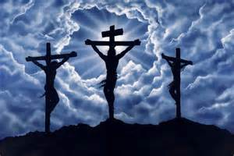
Chapter 23
Jesus Dies for Us

Slide 2
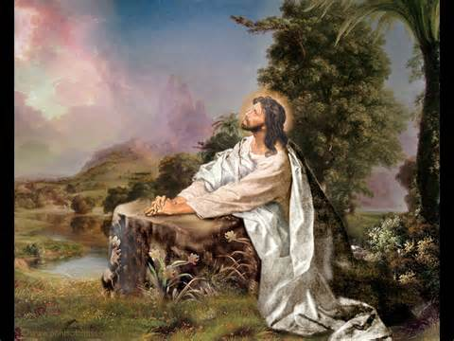
After the Last Supper
Read the first paragraph on pg 113 in the textbook.
Why didn't the disciples pray with Jesus?
Read the second paragraph on pg 113 in the textbook.
Did the soldiers treat Jesus well or did they harm him?

Slide 3
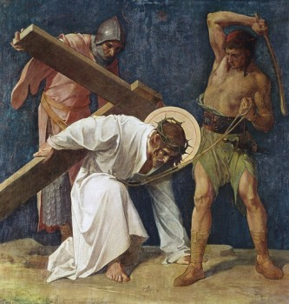
Jesus Carried His Cross
Jesus carried His cross and fell several times.

Slide 4
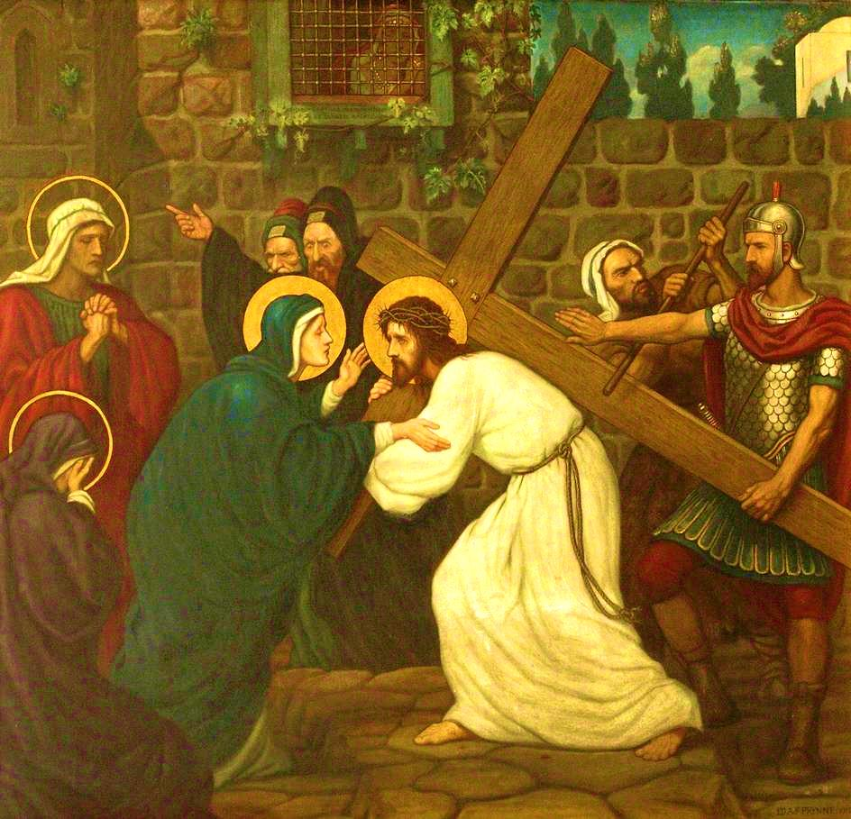
Along the Way to Calvary
Jesus meets His mother

Slide 5
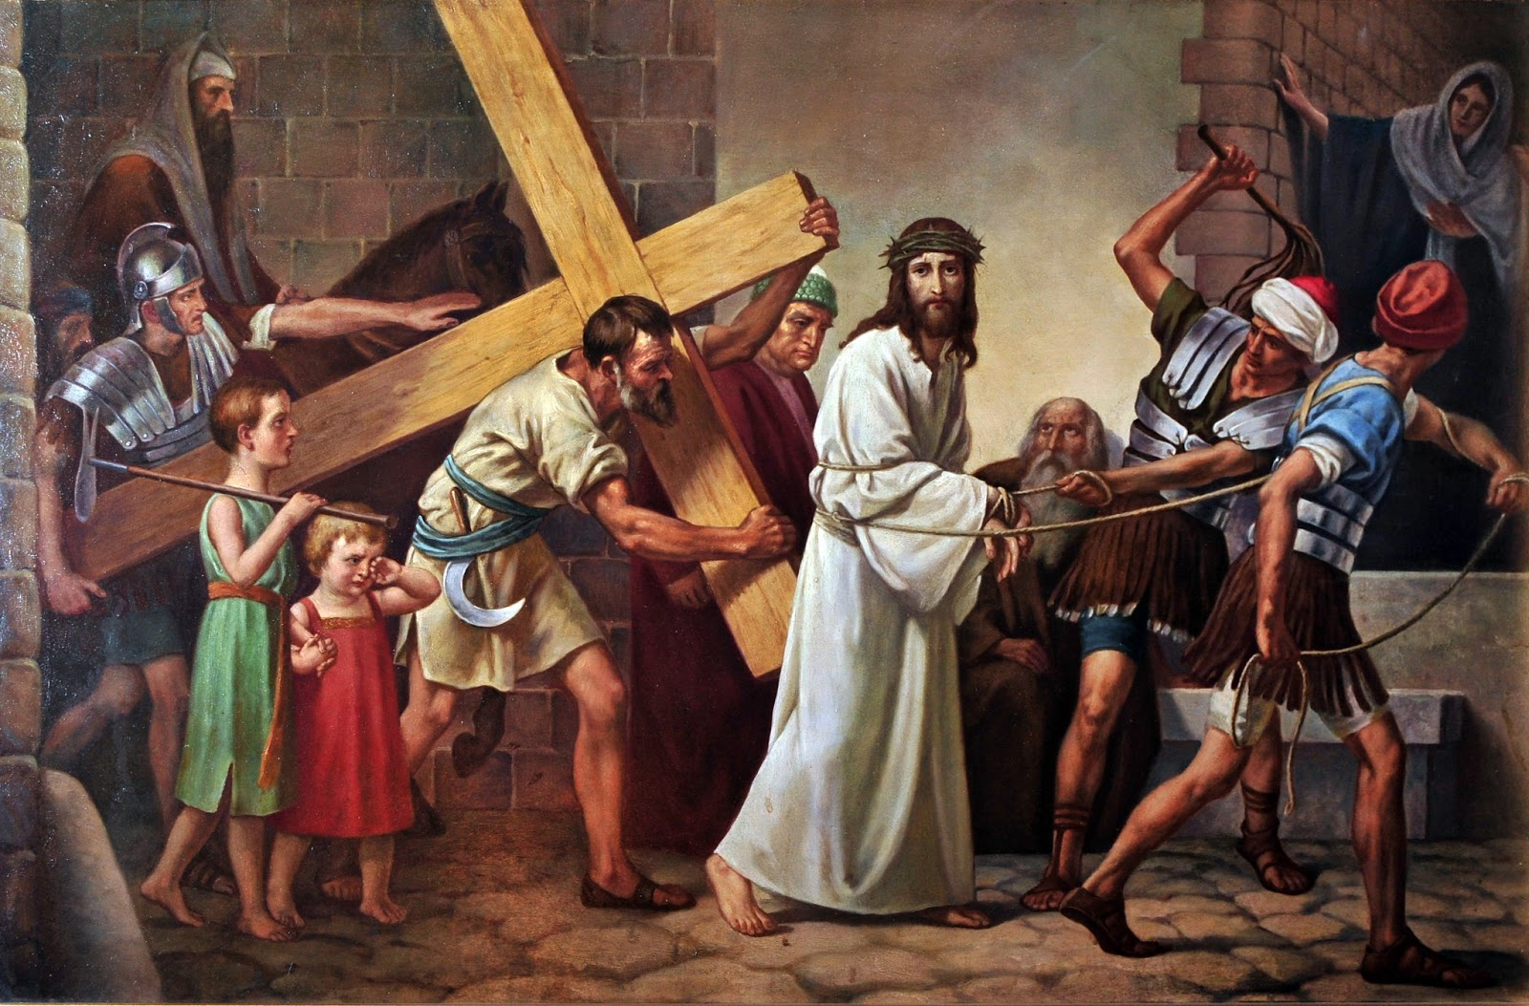
Simon Helped Jesus
Simon helps Jesus carry His cross

Slide 6
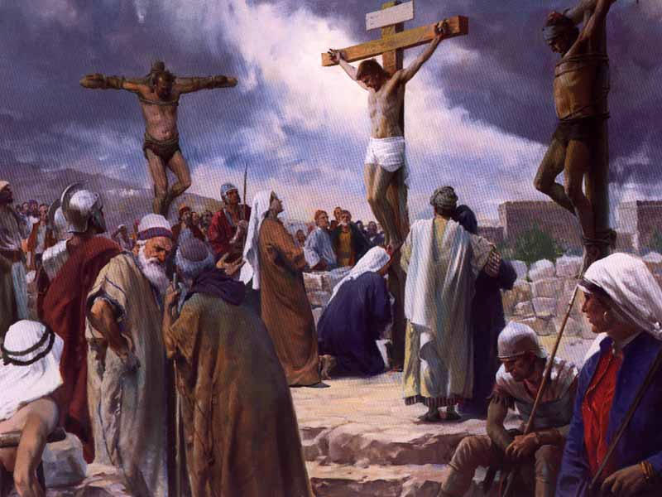
Jesus Died on the Cross

Slide 7
Fruits of Jesus' Death
The death of Jesus opened up the gates of Heaven.
We are now able to have a relationship with God, which Adam and Eve had lost.
The Sacraments are one way we engage in a relationship with Jesus.

