Slide 1
The Last Supper
Chapter 22

Slide 2
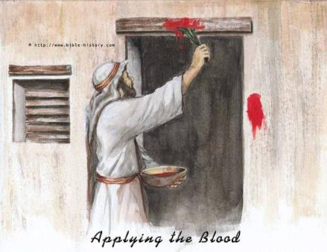
Passover
God lead the people out of slavery in Egypt
10 Plagues
Meal together
Sandals, staff in hand
Lamb, unleavened bread

Slide 3
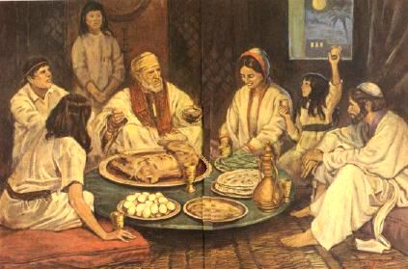
Passover
Celebrated each year
Clean house
Traditional foods

Slide 4
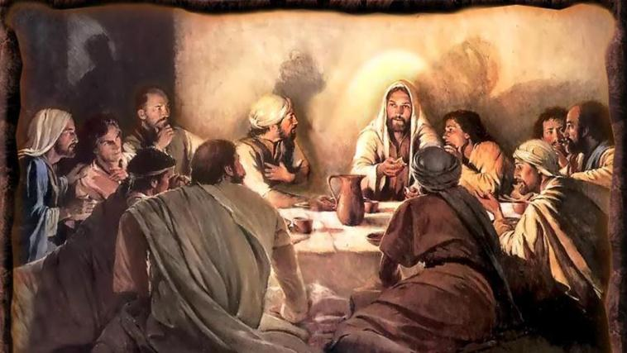
Last Supper
Passover Meal
Lamb, unleavened bread, wine, bitter herbs

Slide 5
Last Supper
1. At the Last Supper, Jesus instituted the Eucharist.
2. With the words of Jesus, bread and wine were changed into His Body, Blood, Soul, and Divinity, really and truly present under the appearance of bread and wine.
3. Jesus gave the power to the Apostles (and through them to every priest) to change bread and wine into His Body and Blood when He said, “Do this in memory of Me.”

Slide 6
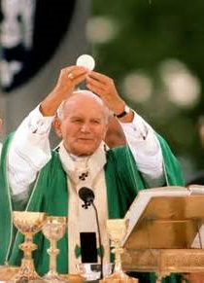
Consecration
Part of the Mass when the bread and wine change into the Body and Blood, Soul and Divinity of Jesus through the words of the priest that Jesus said at the Last Supper
“This is My Body…”
“This is My Blood…”

Slide 7
Consecration
Who consecrates?
A priest
What are the words of Consecration? (Form)
“This is my Body”
“This is my Blood”
What does Father use?
Bread and wine
What happens?
The bread and wine becomes the Body and Blood of Jesus

Slide 8
Transubstantiation
Before Consecration:
Appearance –
Bread
Wine
Substance –
Bread
Wine
John 6:35-59 ~ Bread of Life
After Consecration:
Appearance –
Bread
Wine
Substance –
Christ’s Body, Blood, Soul, and Divinity

