Slide 1
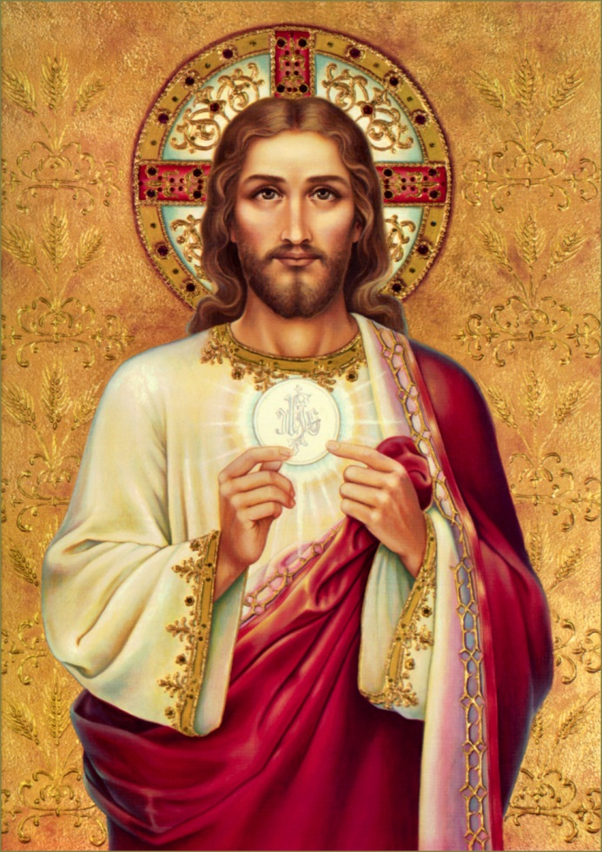
Jesus Comes to Us
Chapter 27

Slide 2
Consecration
Part of the Mass when the bread and wine change into the Body and Blood, Soul and Divinity of Jesus through the words of the priest that Jesus said at the Last Supper
“This is My Body…”
“This is My Blood…”

Slide 3
Consecration
Who consecrates?
A priest
What are the words of Consecration? (Form)
“This is my Body”
“This is my Blood”
What does Father use? (Matter)
Bread and wine
What happens?
The bread and wine becomes the Body and Blood of Jesus

Slide 4
Transubstantiation
Before Consecration:
Appearance –
Bread
Wine
Substance –
Bread
Wine
John 6:35-59 ~ Bread of Life
After Consecration:
Appearance –
Bread
Wine
Substance –
Christ’s Body, Blood, Soul, and Divinity

Slide 5
Three Memorial Acclamations
We proclaim your death O Lord and profess your resurrection until you come again.
Save us, Savior of the World, for by your cross and resurrection you have set us free.
When we eat this bread and drink this cup, we proclaim your death, O Lord, until you come again.

Slide 6
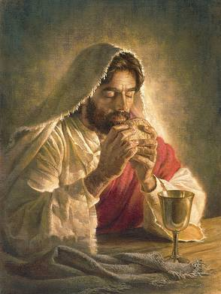
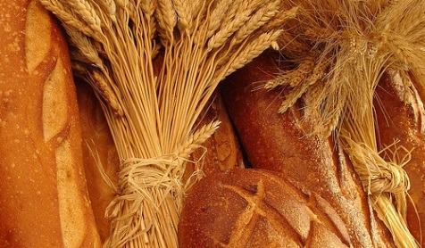
Food for our bodies Food for our Souls
Keeps us alive
Must have to live
Makes us strong, builds muscles
Helps us grow
Helps us stay healthy
Keeps our souls alive
Must have to live God’s life
Makes us strong to resist temptation
Helps us become saints
Helps us do what is right

Slide 7
When we receive Communion
We never want to receive communion when we have a mortal sin on our soul.
We must go to confession before we receive communion if we have committed a mortal sin!
Receiving a communion with a mortal sin on our soul is called a sacrilege.

